Slide 1

Lab 2.3b- Sample Models Example
Notes:
1

Slide 2
Objectives
This example demonstrates how a sample model can be used to simulate the dynamics of a grid world environment, allowing agents to explore and learn from experience.
Lab 2.3b- Sample Models Example
2
Notes:
2

Slide 3
Lab Guide Coding
Using given code
We define a simple grid world environment using the GridWorld class, where the agent can move up, down, left, or right.
The SampleModel class represents the sample model for the environment. It allows us to simulate the environment dynamics based on a given state and action.
Lab 2.3b- Sample Models Example
3
Notes:
3

Slide 4
Lab Guide Coding
Using given code
We create an instance of the grid world environment and the sample model.
We simulate a step in the environment by selecting a random action and obtaining the next state based on the action taken.
Finally, we print the simulated transition from the current state to the next state..
Lab 2.3b- Sample Models Example
4
Notes:
4

Slide 5
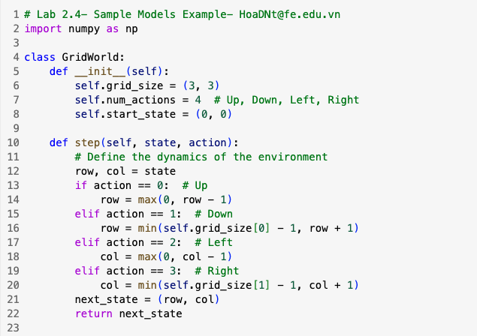
Lab Guide Coding
Lab 2.3b- Sample Models Example
5
Notes:
5

Slide 6
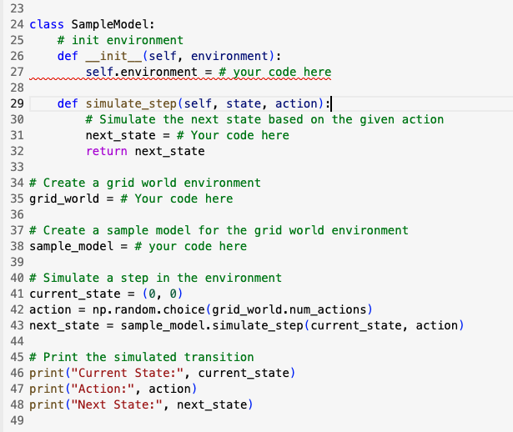
Lab Guide Coding
Lab 2.3b- Sample Models Example
6
Notes:
6

Slide 7
Q & A
Lab 2.3b- Sample Models Example
7

